Slide 2
Transforming our world
through the shifting of minds

Slide 3
The AI-Powered Consultant: Mastering AI-Prompting as Your New Superpower
Dr. Alan Warr

Slide 4
Introductions

Slide 5

Speaker
Dr. Alan Warr
© Metanoia London Ltd, 2023

Slide 6
Agenda
1
Intro to Generative AI & Prompting
2
Basic Prompting
3
Advanced Prompting
4
Embedded Prompting
5
Prompt-Enabled LLM Apps
6
Transformational Prompting AI
7
Prompting AI as a Strategic Opportunity
© Metanoia London Ltd, 2023

Slide 7






KISS – Limiting Our Tech Stack for this Workshop
Principles and prompts and approaches should broadly apply to other GenAI technologies
OpenAI
Text 2 Text LLM (ChatGPT4) | API | Embedding Algorithm Text to Image LLM (Dall-E)
Google Colab
Python Notebooks
PineCone
(Vector) Storage for local knowledge bases
LangChain
Prompt Automation & Orchestration
Streamlit
UI for LLM Apps
Python
Coding
© Metanoia London Ltd, 2023

Slide 8

Resources & Open Source Licensing
All materials & notebooks are at GitHub
https://github.com/MetanoiaLondon/prompting-ai-superpower
MIT license
© Metanoia London Ltd, 2023

Slide 9
Poll

Slide 10
Poll 1: How good is your superpower?
1
Curious: Nothing yet, what’s this all about?
2
Experimenting: I’m trying out some Chatbots (or similar) now?
3
Planned: I haven’t done much yet, but I’m committed
4
Getting There: I’m using basic Prompting in my work or life?
5
Advanced: I’m well above basic Prompting now?
6
Powerful: I’m advanced and getting into LLM apps, agents, etc.?
7
God-like: I’ll blow your minds with examples in the Q&A later?
10
© Metanoia London Ltd, 2023
© Metanoia London Ltd, 2023

Slide 11
Intro for Generative AI & Prompting

Slide 12

Definitions
AI
AI, or Artificial Intelligence, refers to the development of computer systems that can perform tasks that typically require human intelligence, such as learning, problem-solving, and decision-making.
Generative AI
Generative AI is a subset of artificial intelligence that focuses on creating data, content, or responses, often mimicking human creativity and generating new information or outputs based on learned patterns and data.
LLMs
LLMs (Large Language Models) are advanced AI systems that can understand and generate human-like text, while Chatbots are applications powered by LLMs that engage in natural language conversations with users, providing information, assistance, or performing tasks.
Prompting
Prompting, in the context of AI, is the action of providing a specific instruction, question, or command to an AI system or chatbot to elicit a desired response or action, facilitating interactive communication and task execution.
© Metanoia London Ltd, 2023

Slide 13
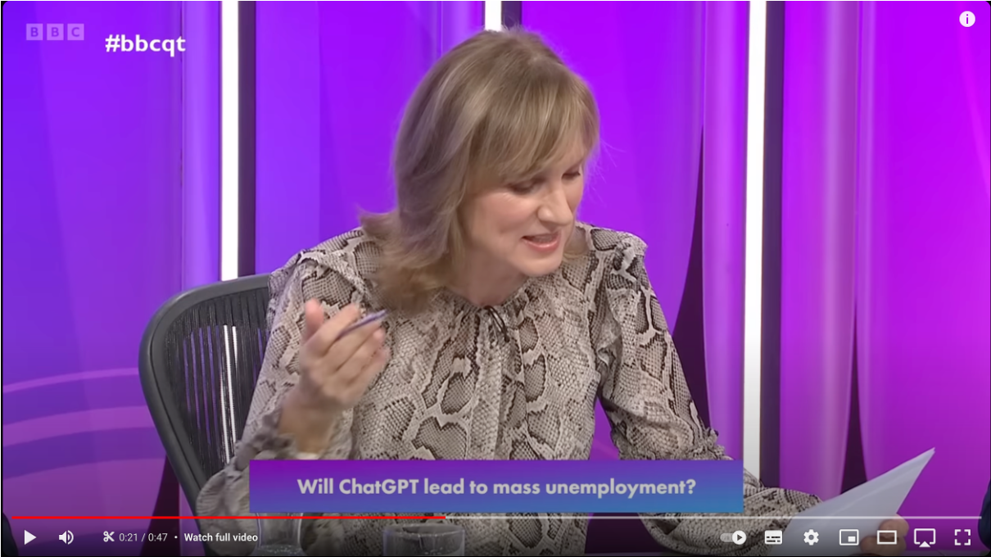
Use Case: Shakespearian intro to Question Time
© Metanoia London Ltd, 2023
https://youtube.com/clip/UgkxPWLuNxod_0lKJN4SRdnQaK6kt8gfOg1-?si=u5D5OxQ5ZT6xkB_j

Slide 14
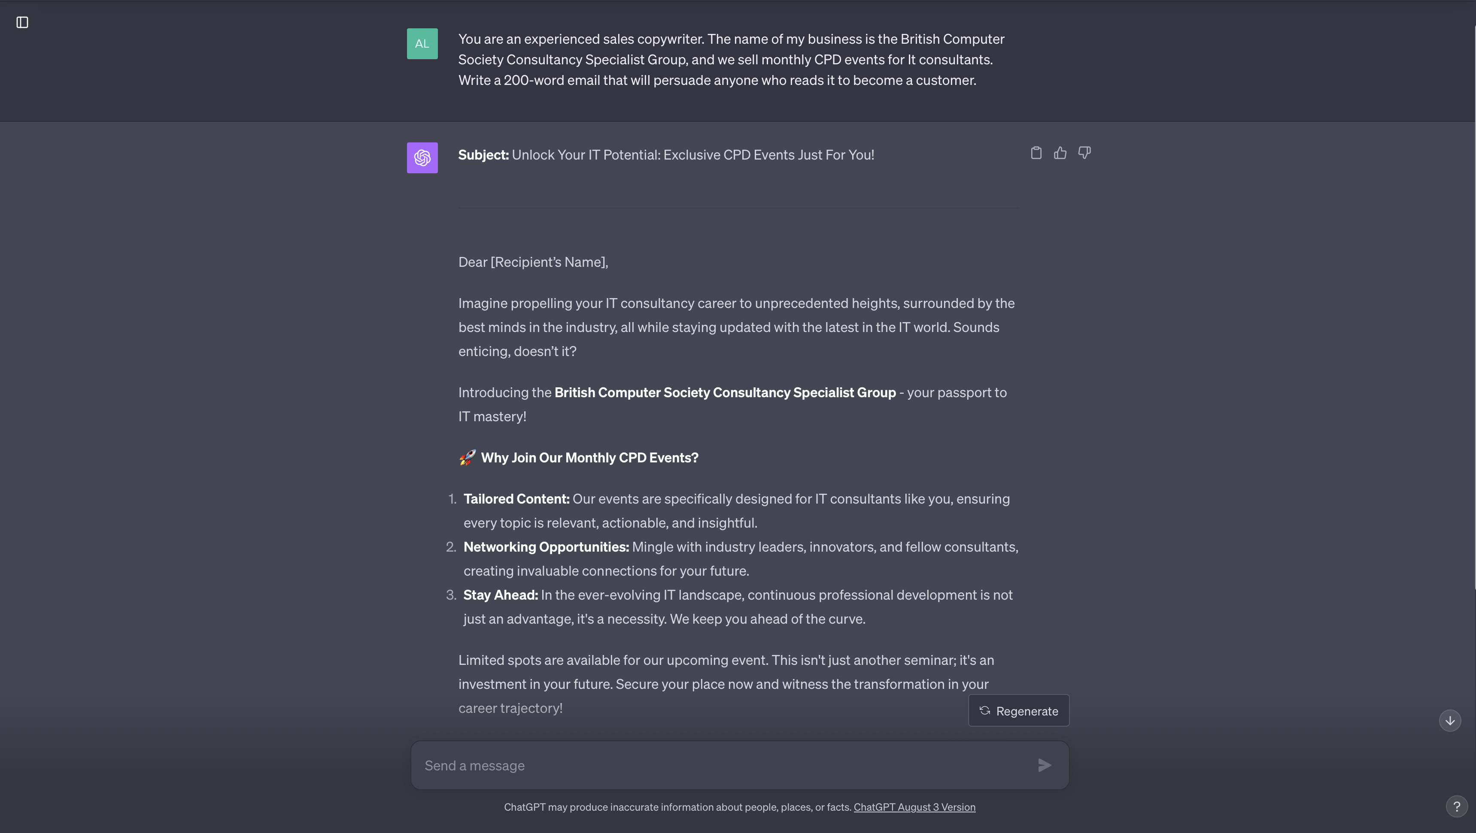
Use Case: Prompt to write a marketing e-mail
© Metanoia London Ltd, 2023

Slide 15
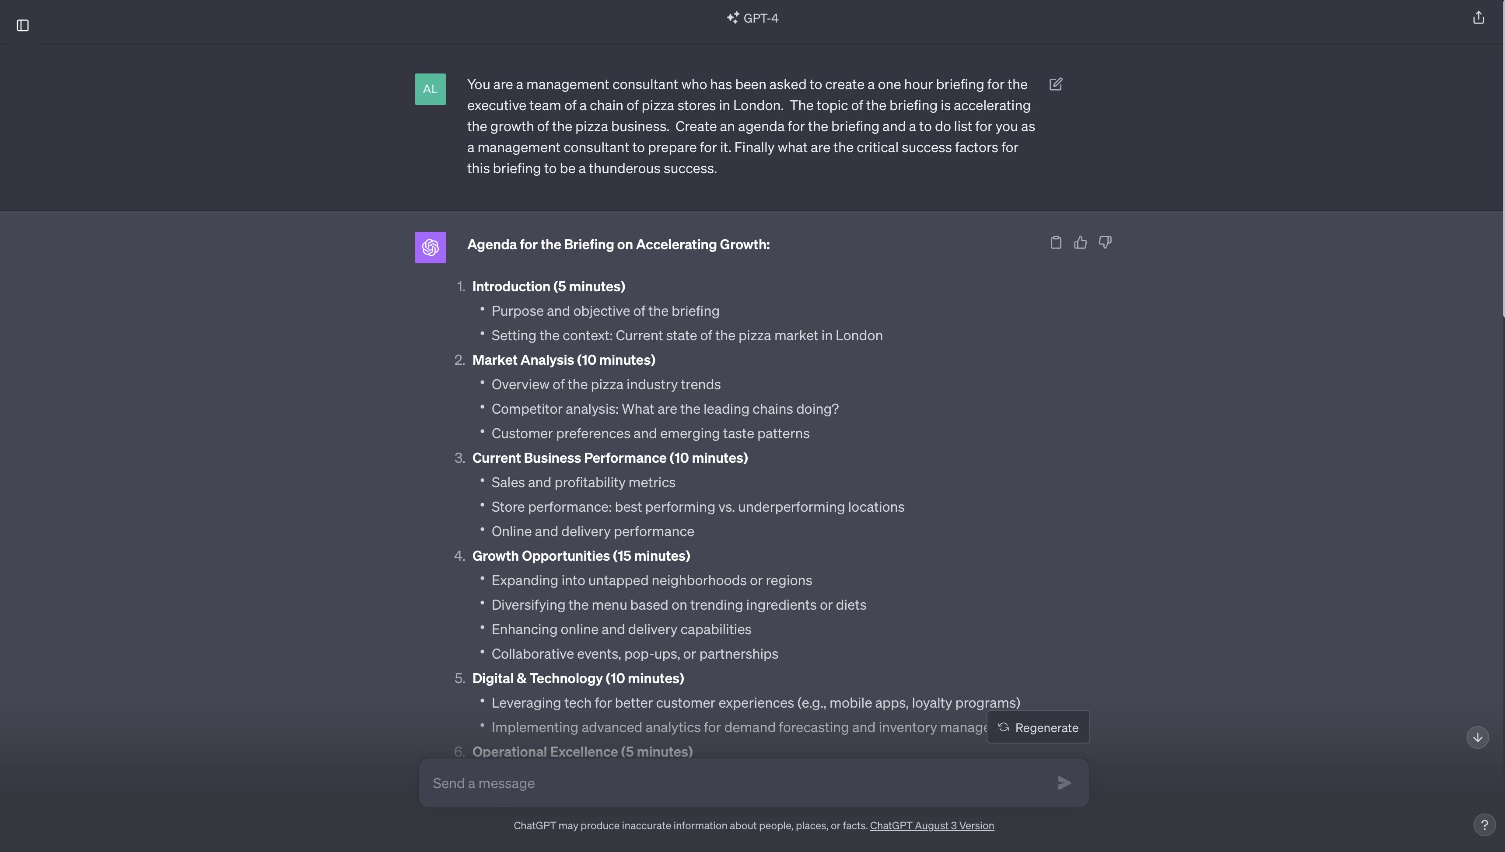
Use Case: Design a Consulting Workshop
© Metanoia London Ltd, 2023

Slide 16
GenAI in Consultancy

Slide 17
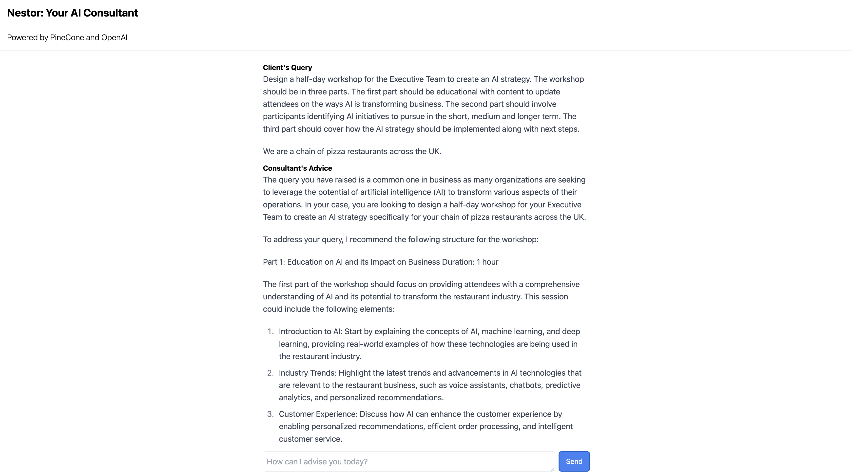
Project Nestor is aiming to expand consultancy’s reach
© Metanoia London Ltd, 2023

Slide 18
Basic Prompting

Slide 19

Simple Prompting
Dall-e Prompt: Irish forest by David Hockney, --ar 1:1

Slide 20
Naive Prompting

Slide 21
Zero Shot Prompting

Slide 22
Iterative Prompting

Slide 23
Role Prompting

Slide 24
Critical Agent Prompting

Slide 25
One Shot Prompting

Slide 26
Few Shot Prompting

Slide 27
Chain of Thought Prompting

Slide 28
Including Output Formats

Slide 29
Prompting Parameters for Text to Text LLMs

Slide 30
Cheat Sheet for ChatGPT4

Slide 31
Advanced Prompting

Slide 32
Text to Image Prompting with Dall-E

Slide 33
Cheat Sheet for Dall-E

Slide 34
Combining Text to Text & Text to Image Prompting

Slide 35
Prompting for Code Completion

Slide 36
Prompt Chaining

Slide 37
Embedded Prompting

Slide 38
Prompt-Enabled LLM Apps

Slide 39
Transformation Prompting AI

Slide 40
Prompting AI as a Strategic Opportunity

Slide 41
© Metanoia London Ltd, 2023

Slide 42
Poll

Slide 43
Poll 2: How much of a Superpower is this?
Optional Capability?
1
None
2
Just Useful
3
Optional Capability
4
Very Important
5
Competitive Advantage
6
Critical to a Long-Term Career
7
Potentially Master of the Universe
© Metanoia London Ltd, 2023
43
© Metanoia London Ltd, 2023

Slide 44
Q&A

